Slide 1
Inspiring Hope

Slide 2
Matthew 11:28-30 (NIV)
Come to me, all who are weary and burdened, and I will give you rest. Take my yoke upon you and learn from me, for I am gentle and humble in heart, and you will find rest for your souls. For my yoke is easy and my burden is light.

Slide 3
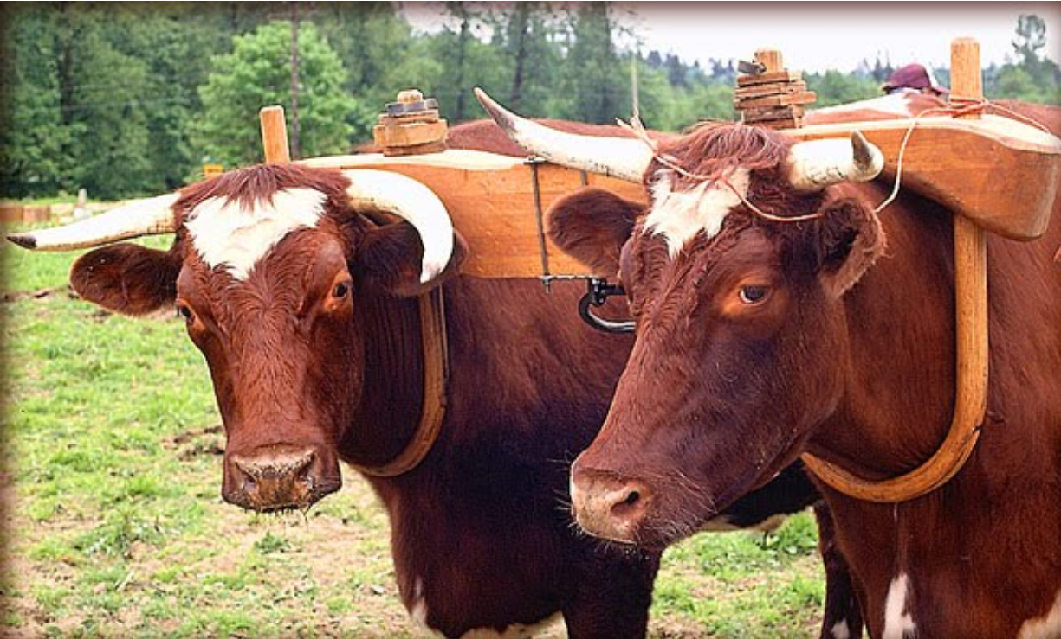

Slide 4
Come
Stay
Rest

Slide 5
Silent reflection on what God wants to do in and through our lives
We must have humility before God and others.
Self-control in the face of adversity
A confident patience from what God is desiring to teach us

Slide 6
“God does not promise to keep us out of the storms of life, but He does promise to sustain us in the storm, and then bring us out in due time for His glory when the storm has done its work.”
Warren Wiersbe

