Slide 1
New Life, New Nature, New Freedom
( The Gift of a Letter—Priceless!)

Slide 2
Book of Romans, Facts:
Author: Paul
Theme: Salvation by Grace through Faith
Considered Paul’s “Masterpiece”
Has nearly every major doctrine of the Christian Faith
Three key words: law(78), righteousness(66), faith(62)
It is so foundational to the faith that it has been called the “Constitution of Christianity”

Slide 3
Chapters 1-11 concern doctrine (what we believe)
Chapters 12-16 highlight duty (how we behave)
Main Theme: Salvation/God’s Righteousness
Topics: sin, salvation, redemption, justification, grace, and reconciliation.

Slide 4
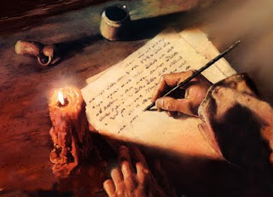
This Photo by Unknown Author is licensed under CC BY-NC-SA

Slide 5
Background
Purpose
Date/Setting
Audience

Slide 6
Romans 6:1-23
Dead to sin, Alive to God (1-14)
From Slaves of Sin to Slaves of God (15-23)

Slide 7
The Relationship between Justification & Sanctification
Justification
Sanctification
Act of the Spirit in us
The beginning of the process
Declares us righteous
Removes the guilt & penalty of sin
The work of the Spirit through us
A transformation
Moves us toward righteousness
Removes the power of sin

Slide 8
Charles Spurgeon, “Everyday we have to die out to self—when we get to the end of our self, we get to the beginning of God.”
Galatians 2:20

Slide 9
“We dye to live, we live to dye; the more we dye, the more we live; and the more we live, the more we dye.”
(sign in the window at a dry cleaners)

Slide 10
Max Lucado, “Grace is the voice that calls us to change and then gives us the power to pull it off!”
New Life, New Nature, New Freedom
The Gift of a letter—Precious
The Gift of God’s Righteousness—Priceless!

