Slide 2
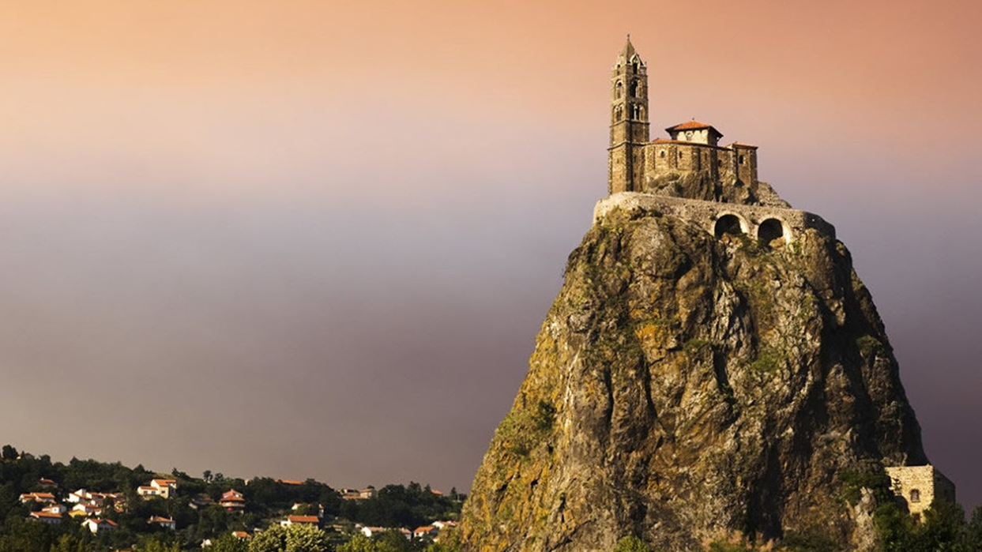
House Upon the Rock

Slide 3
Matthew 7:24-27
"Everyone then who hears these words of mine and does them will be like a wise man who built his house on the rock. And the rain fell, and the floods came, and the winds blew and beat on that house, but it did not fall, because it had been founded on the rock.
And everyone who hears these words of mine and does not do them will be like a foolish man who built his house on the sand. And the rain fell, and the floods came, and the winds blew and beat against that house, and it fell, and great was the fall of it."

Slide 4
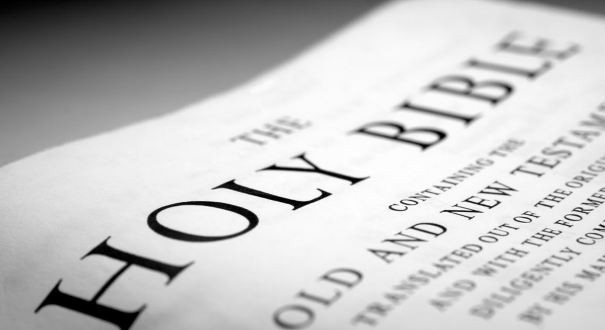
The Bible is God’s Message

Slide 5
Getting Started
Genesis 1:3
2 Timothy 3:16
2 Peter 3:15-16

Slide 6
Getting Started
Genesis 1:3 – And God said, "Let there be light," and there was light.
2 Timothy 3:16
2 Peter 3:15-16

Slide 7
Getting Started
Genesis 1:3 – And God said, "Let there be light," and there was light.
2 Timothy 3:16 – All Scripture is breathed out by God… for teaching, reproof, correction…
2 Peter 3:15-16

Slide 8
Getting Started
Genesis 1:3 – And God said, "Let there be light," and there was light.
2 Timothy 3:16 – All Scripture is breathed out by God… for teaching, reproof, correction…
2 Peter 3:15-16 – our beloved brother Paul also wrote… the ignorant and unstable twist to their own destruction, as they do the other Scriptures

Slide 9
The Bible has authority because God’s words have authority

Slide 10
Is the Bible your authority?
Can it change your mind?

Slide 11
Is the Bible your authority?
2. Can it change your direction?

Slide 12
Is the Bible your authority?
3. Does it trump all other authorities?

Slide 13
Psalm 19:7-11
Find your one thing

