Slide 2
Grande Finale
FOR DIFFERENT PEOPLE

Slide 3
…I Don’t Feel It

Slide 4
But I, O LORD, cry to you; in the morning my prayer comes before you.
¹⁴ O LORD, why do you cast my soul away? Why do you hide your face from me?
(Ps. 88:13-14 ESV)

Slide 5
I may not feel God’s presence because…
1. I’m expecting too much

Slide 6
John 6:30-31
So they said to him, "Then what sign do you do, that we may see and believe you? What work do you perform?
Our fathers ate the manna in the wilderness; as it is written, 'He gave them bread from heaven to eat.'"

Slide 7
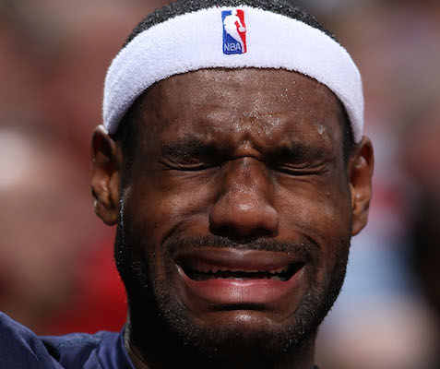
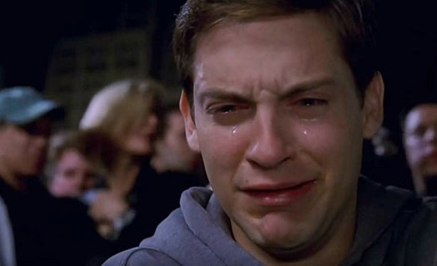

Slide 8
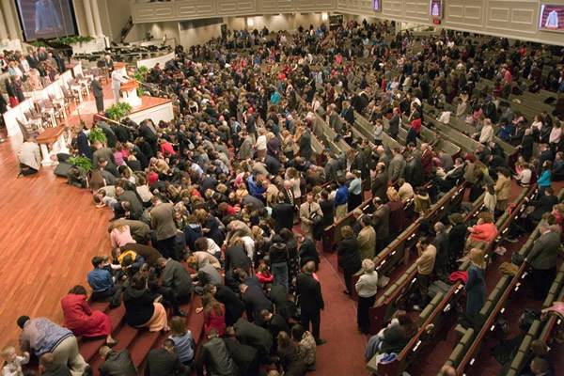

Slide 9
I may not feel God’s presence because…
2. My heart may be hardened

Slide 10
Matthew 13:15
For this people's heart has grown dull, and with their ears they can barely hear, and their eyes they have closed, lest they should see with their eyes and hear with their ears and understand with their heart and turn, and I would heal them.

Slide 11
you will seek the LORD your God and you will find him, if you search after him with all your heart and with all your soul.
(Deut. 4:29 ESV)

Slide 12
I love those who love me, and those who seek me diligently find me.
(Prov. 8:17 ESV)

Slide 13
You will seek me and find me, when you seek me with all your heart.
(Jer. 29:13 ESV)

Slide 14
Ask, and it will be given to you; seek, and you will find; knock, and it will be opened to you.
For everyone who asks receives, and the one who seeks finds, and to the one who knocks it will be opened.
(Matt. 7:7-8 ESV)

Slide 15
I may not feel God’s presence because…
3. God is drawing me closer

Slide 16
Acts 17:26-27
And he made from one man every nation of mankind to live on all the face of the earth, having determined allotted periods and the boundaries of their dwelling place,
that they should seek God, and perhaps feel their way toward him and find him. Yet he is actually not far from each one of us…

Slide 17
What's more important
(and biblical)
for me is...
Seeking God with all my heart

