Slide 2
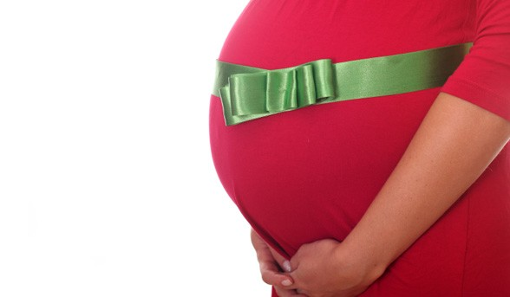
Pregnant
Expecting Great Things from God This Christmas

Slide 3
Why Christmas is Joyful
Psalm 98

Slide 4
Definition: Joy
Feeling – Joy is a feeling called forth by well-being, success, or good fortune. A person automatically experiences it because of certain favorable circumstances. It cannot be commanded.

Slide 5
Definition: Joy (continued)
Action – There is a joy that Scripture commands. That joy is action that can be engaged in regardless of how the person feels.
“Rejoice”

Slide 6
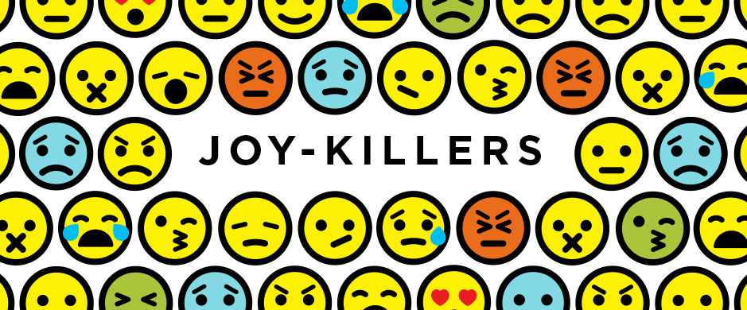
Unbelief is a joy killer
The son of David brings order and righteousness

Slide 7
God Delivers On His Promises
Christ’s birth was just the beginning.

Slide 8
It’s Not Supposed to Be Like That
Rom. 8:19-21

Slide 9
Joy from the Holy Spirit
But the fruit of the Spirit is love, joy, peace, patience, kindness, goodness, faithfulness, gentleness, self-control…
Galatians 5:22-23

Slide 10
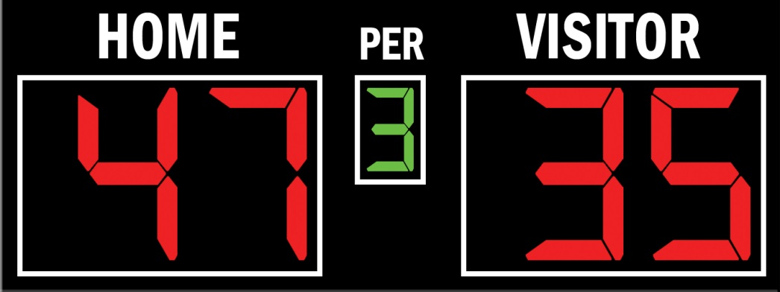
Count It All Joy
Count it all joy, my brothers, when you meet trials of various kinds, for you know that the testing of your faith produces steadfastness. And let steadfastness have its full effect, that you may be perfect and complete, lacking in nothing.
James 1:2-4

Slide 11
How will you cultivate the joy of Christmas?
Belief
Just the beginning
God will set things right
Fruit of the Spirit
Count it joy

