Slide 3
Every Thought Captive
Week 2 of How To Be Brave

Slide 4
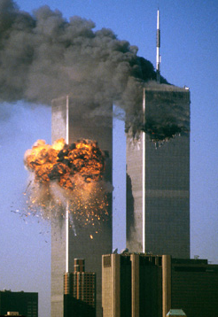
In our thought life, nothing destroys bravery faster than being double-minded.
(James 1:8)

Slide 5
2 Corinthians 10:3-5
For though we live in the world, we do not wage war as the world does. The weapons we fight with are not the weapons of the world. On the contrary, they have divine power to demolish strongholds.

Slide 6
2 Corinthians 10:3-5 (continued)
We demolish arguments and every pretension that sets itself up against the knowledge of God, and we take captive every thought to make it obedient to Christ.

Slide 7
Taking every thought captive begins with intentionally taking sides.

Slide 8
Supplying yourself for battle means filling the pipeline with the right things.

Slide 9
Challenge: Take Sides and Fill
Think about what you’re thinking about
As soon as you realize you’re in the battle, pick a side - don’t let it rage on unattended
What is something that you’re currently putting in your pipeline that needs to come out?
What is something that needs to go in?

