Slide 2
Famous
Last
Words

Slide 3
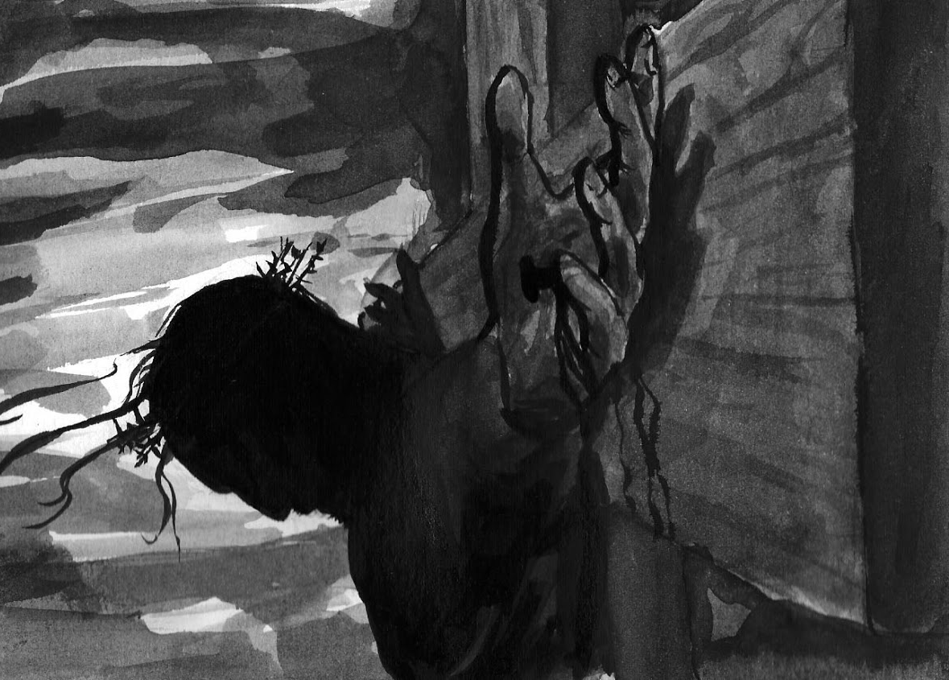
Father Forgive Them
Week 2 of Famous Last Words

Slide 4
Luke 23:33-34
And when they came to the place that is call The Skull, there they crucified Jesus and the criminals, one on his right and one on his left. And Jesus said, “Father forgive them, for they know not what they do.”

Slide 5
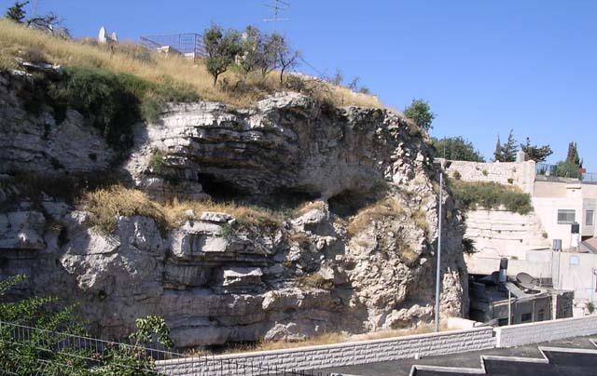

Slide 6
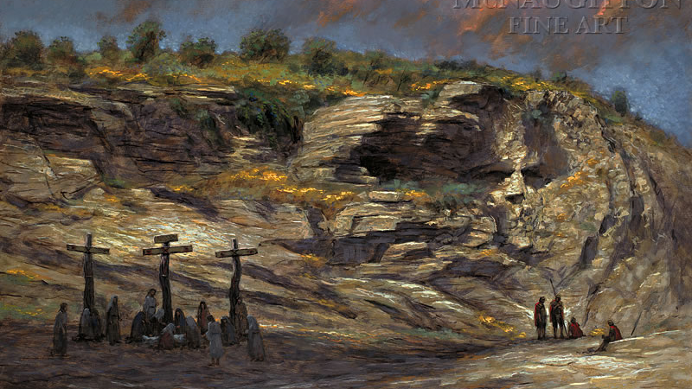

Slide 7
Ignorance does not equal innocence.

Slide 8
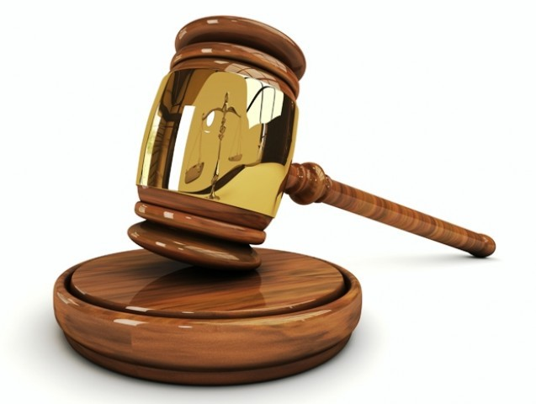
We have an intercessor in heaven!
Notes:
Christ Jesus...who was raised to life is at the right hand of God and is also interceding for us.
Romans 8:34

Slide 9
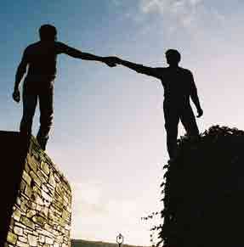
If we forgive and pray for our enemies, we will be blessed.
Notes:
For if you forgive men when they sin against you, your heavenly Father will also forgive you.
But if you do not forgive men their sins, your Father will not forgive your sins.
Matthew 6:14

Slide 10
A True Apology
I am sorry
I take the blame
What can I do to make it right?

Slide 11
Challenge This Week
When challenges come, remember Jesus’ resolve to complete his mission for you.
Be quick to forgive! Is there someone you need to forgive today?
Is there someone you should apologize to? Lent is a great time to get right with them.

