Slide 2
6 People
6 Weeks
6 Fresh Starts

Slide 3
Samaritan Woman - Ditching the Labels
Week 6 of Fresh Starts

Slide 4
John 4:1-43
Jesus and the Woman of Samaria

Slide 5
What negative label has impacted you?
Notes:
Doormat, pushover, never commit, jerk, overly sensitive, temper, irresponsible, average, partier, addict, used/damaged goods, not going to make a difference, too young, too old, ….?
“Not good enough.”

Slide 6
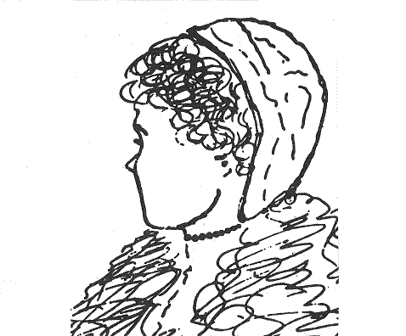

Slide 8
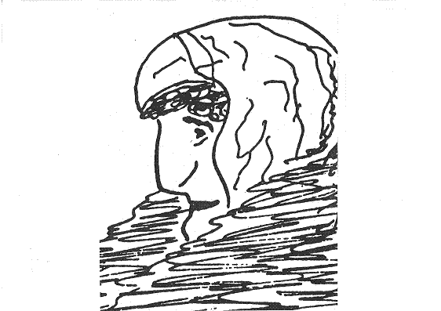

Slide 10
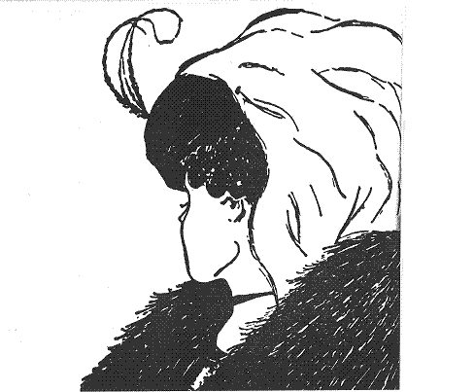

Slide 11
Labels are often based on our perceptions.

Slide 12
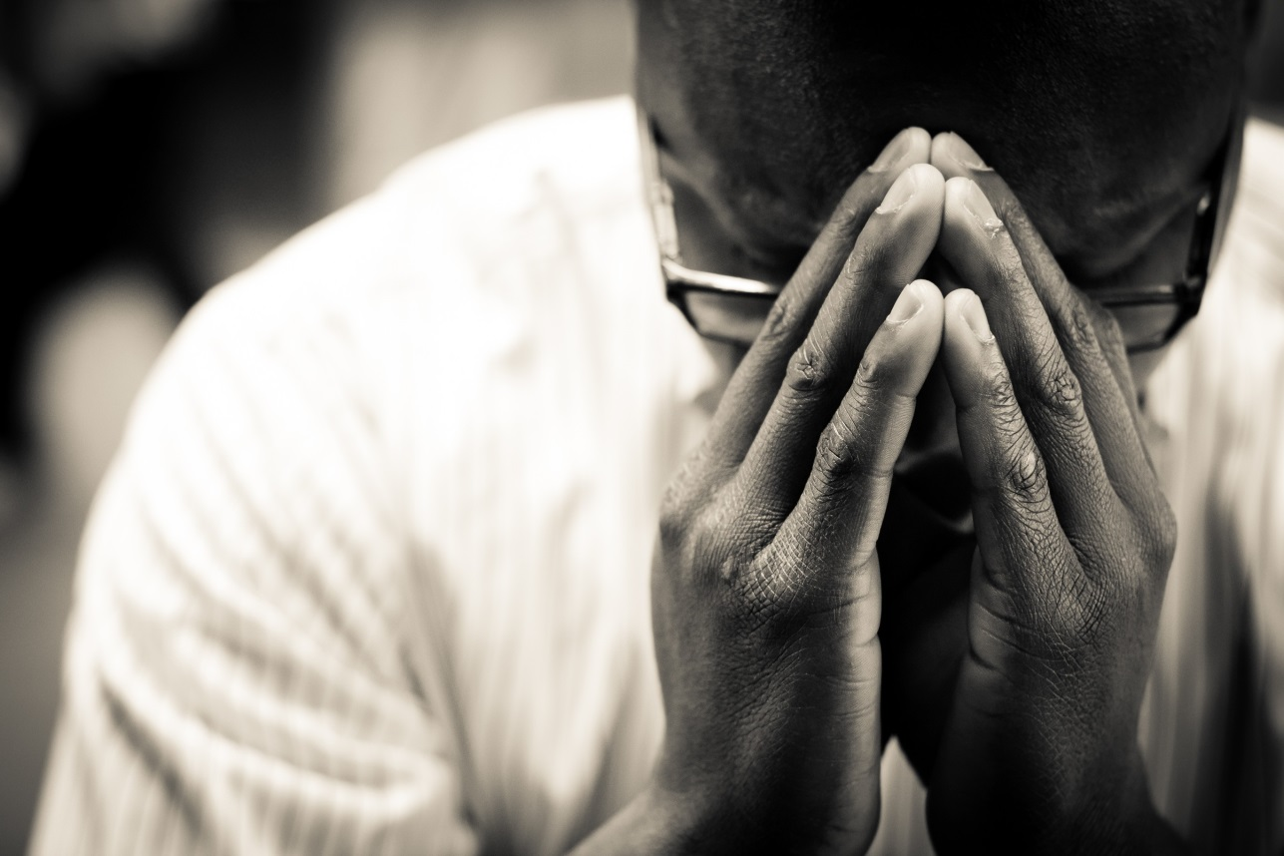
Jesus is not interested in our labels.
He deals with sin and invites everyone to genuine worship.

Slide 13
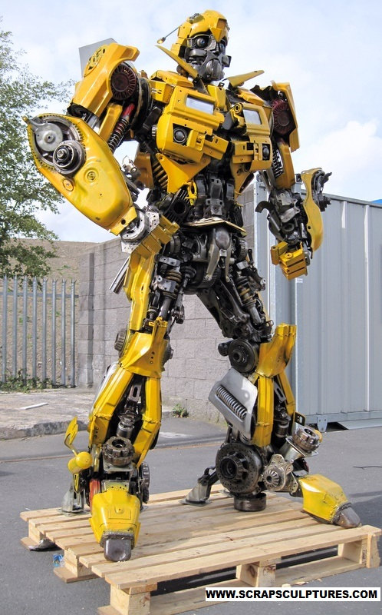
Jesus seeks out messes to turn them into masterpieces.

Slide 14
Challenge
One label I will ditch is ___________
One sin I will let Jesus deal with is _____________
One way I will worship genuinely is _____________

