Slide 2
6 People
6 Weeks
6 Fresh Starts

Slide 3
Levi Celebrates His Fresh Start
Week 5 of Fresh Starts

Slide 4
Luke 5:27-32
After this Jesus went out and saw a tax collector named Levi, sitting at the tax booth. And he said to him, “Follow me.”
And leaving everything, he rose and followed him.

Slide 5
And Levi made him a great feast in his house, and there was a large company of tax collectors and others reclining at table with them.

Slide 6
And the Pharisees and their scribes grumbled at his disciples, saying, “Why do you eat and drink with tax collectors and sinners?”
And Jesus answered them, “Those who are well have no need of a physician, but those who are sick. I have not come to call the righteous but sinners to repentance.”

Slide 7
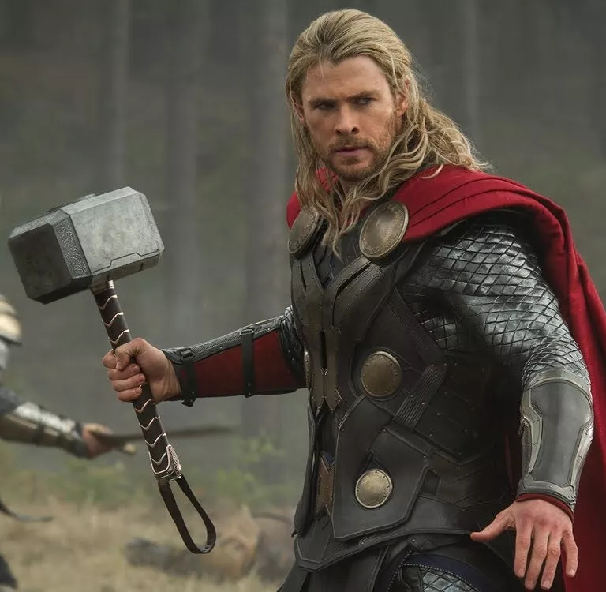
“Victory should be honored with revels.”
-Thor
Notes:
If you’re too religious, you can forget some of the simple truths in life. Even Levi, a tax collector and traitor, knew to celebrate his fresh start in Jesus.

Slide 8
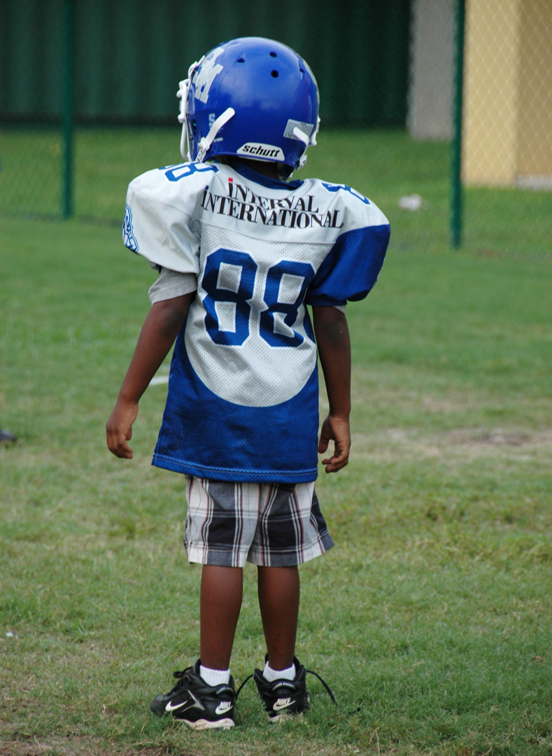
Joy empowers us to take risks for good reasons.

Slide 9
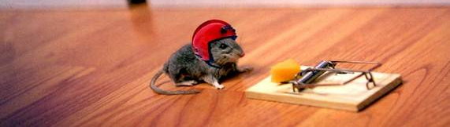
Joy makes us immune to petty, selfish things that try to cripple our fresh starts.

Slide 10
Joy can be restored
“Restore to me the joy of your salvation” - Psalm 51:12

Slide 11
7-Day Challenge
Each morning, recall one reason for the joy of your salvation or fresh start
_X_ _X_ _X_ _X_ _X_ _X_ _X_

