Slide 3
An Important Mission
Jeremiah 1

Slide 4
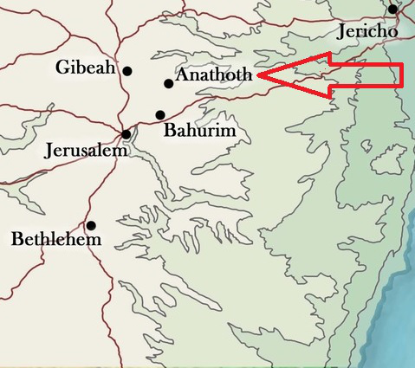
When God Calls, He Generally…
1. Calls first

Slide 5
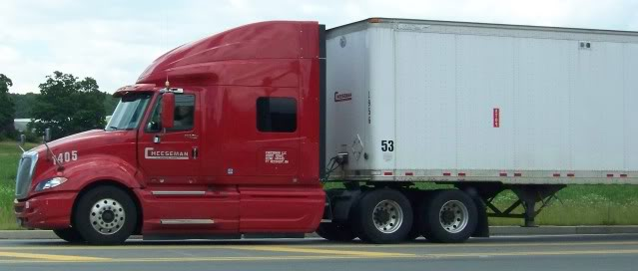
When God Calls, He Generally…
2. Prepares and equips us

Slide 6
When God Calls, He Generally…
3. Intends to use us
for His sovereign plan
for the good of others

Slide 7
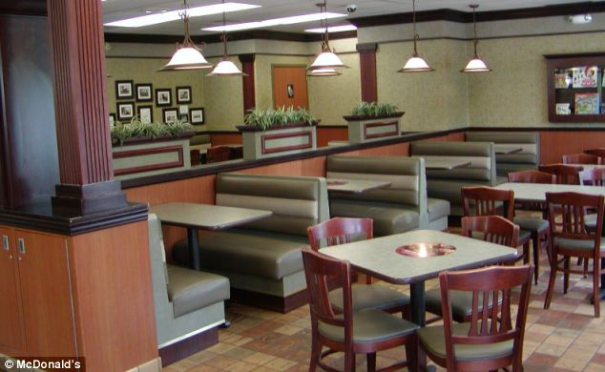
When God Calls, He Generally…
4. Expects us to answer

Slide 8
Challenge
How has God called me
for his sovereign plan
for the good of others?

