Slide 2
Quest’s Mission
Meeting people where they are;
traveling with them to where Jesus Christ is leading

Slide 3
Values:
Powerful Prayer
Authentic Relationships
Transforming Grace
Radical Generosity
Intentional Hospitality
Creative Outreach

Slide 4
We seek to glorify God by being a Christ-centered church that loves and serves others through the empowering of the Holy Spirit.
Quest Vision Statement

Slide 5
Matthew 10
Jesus sends out the 12 apostles

Slide 6
And he called to him his twelve disciples and gave them authority over unclean spirits, to cast them out, and to heal every disease and every affliction…

Slide 7
These twelve Jesus sent out, instructing them, “Go nowhere among the Gentiles and enter no town of the Samaritans, but go rather to the lost sheep of the house of Israel. And proclaim as you go, saying, ‘The kingdom of heaven is at hand.’ Heal the sick, raise the dead, cleanse lepers, cast out demons.

Slide 8
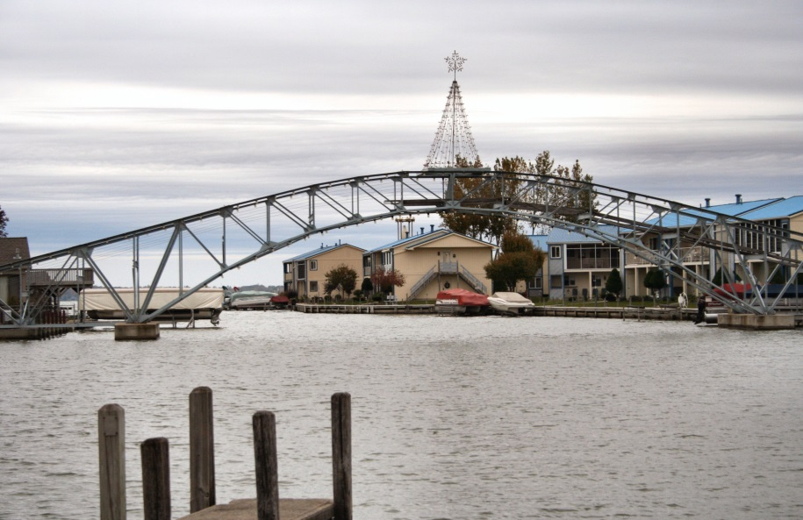
Go – We are sent by Jesus to reach others

Slide 9
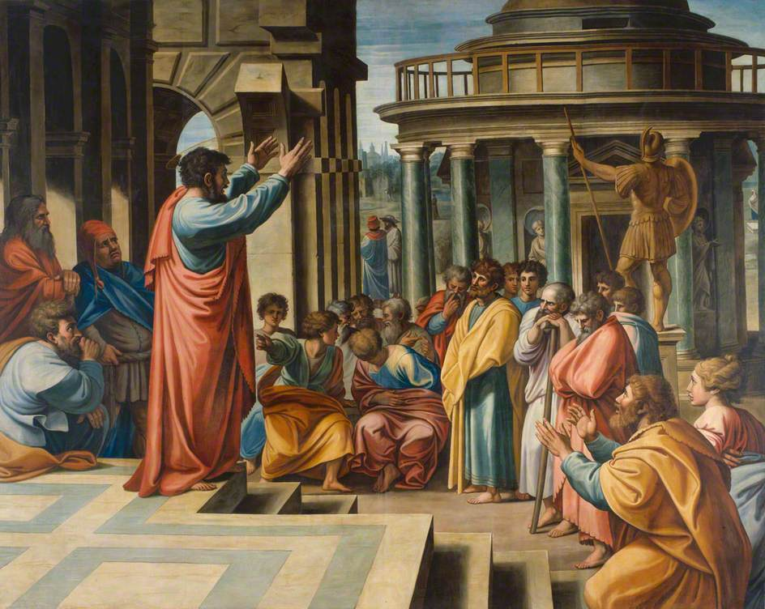
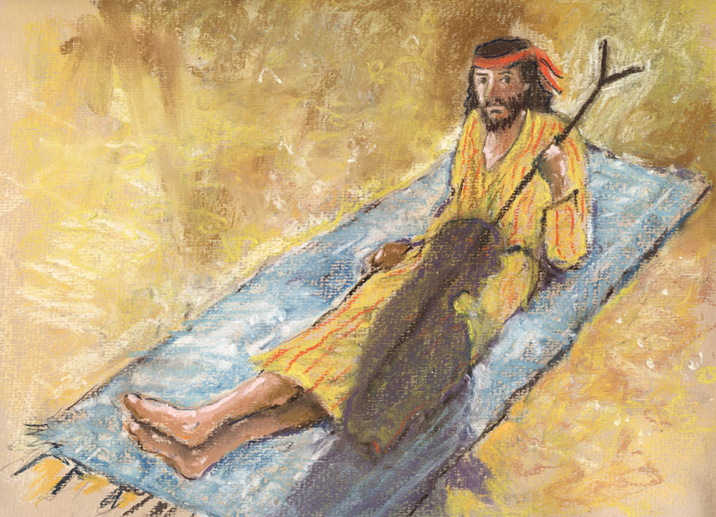
Serve – We are gifted to reach and bless others

Slide 10
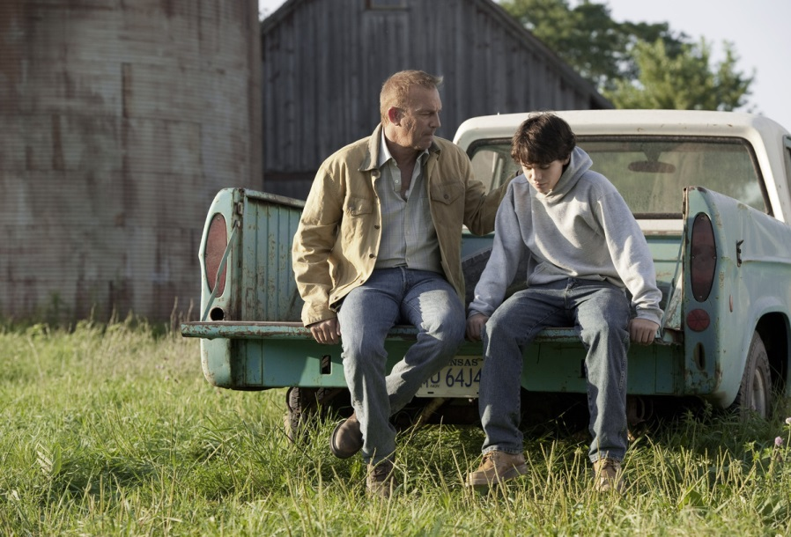
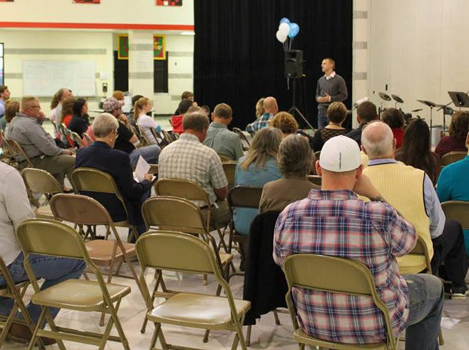
Tell – We tell God’s message as we go and serve

Slide 11
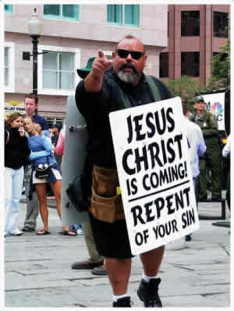
God’s Way – We do all of it God’s way

Slide 12
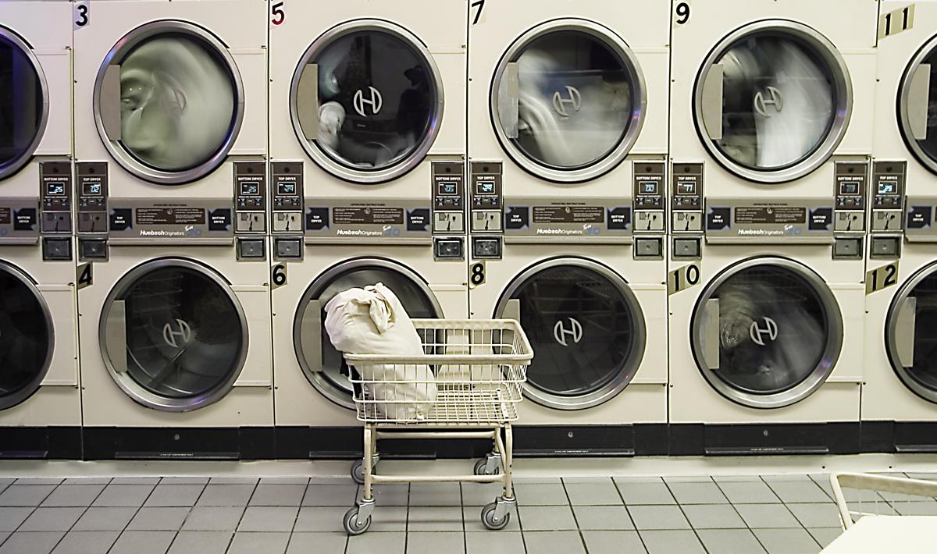
One example from this week…

Slide 13
Why go, serve, and tell?

Slide 14
We seek to glorify God by being a Christ-centered church that loves and serves others through the empowering of the Holy Spirit.

